Slide 1
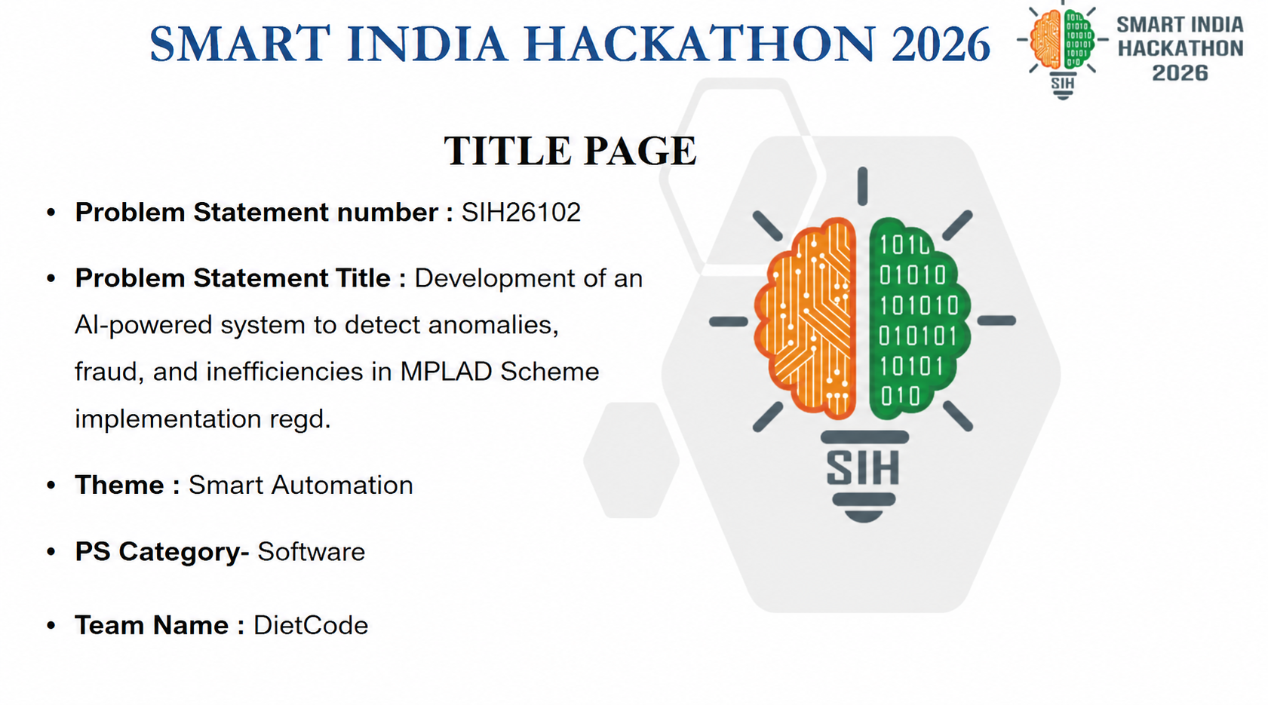

ARTHSETU

Slide 2


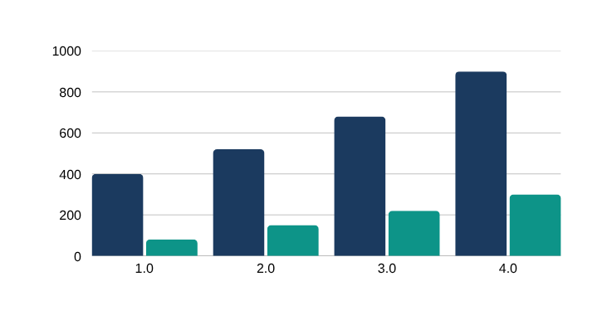
DietCode
THE PROBLEM
MPLADS monitoring today is a reporting system — not a control system.
01
02
03
Money tracked only after spending
Money and work are tracked separately
Dashboards report — they don’t control
Reports arrive after funds are spent, making corrective action too late.
Financial records and physical progress sit in different records, with no automatic cross-check.
Existing portals show progress but do not decide whether the next payment should be released.
THE OPPORTUNITY
Expenditures vs Verified Progress (Current System)
Move MPLADS from reporting to controlled fund release — every next payment depends on verified spending and verified work.
Financial Expenditure
Verified Physical Progress
DETECT
›
VERIFY
›
ACCOUNT
›
APPROVE
›
RELEASE
ArthSetu · SIH 26102 · Idea Submission
02

Slide 3

DietCode
ArthSetu — four connected layers that turn fund monitoring into gated fund release.
LAYER 01
LAYER 02
LAYER 03 · CORE
LAYER 04
AI Risk Detection
Evidence & Verification
Conditional Funding
Transparency & Audit
Links each milestone to geotagged photos, bills, measurements, and field checks.
The Accountability Gate: the next payment unlocks only after the current milestone is verified.
Every decision is recorded, auditable, and visible through a citizen-facing transparency page.
Flags unusual spending, cost overruns, delays, and gaps between reported spending and physical progress.
→
→
→
AI gives risk-based decision support; humans take the final call.
No automated punitive action.
Every gate decision is officer-approved
MPLADS ArthSetu · SIH 26102 · Idea Submission
03
ArthSetu · SIH 26102 · Idea Submission
03

Slide 4


DietCode
From project sanction to the next payment in 9 controlled steps.
1
PROJECT APPROVED +
BUDGET ALLOCATED
2
FUNDS RELEASED FOR
CURRENT STAGE
3
WORK COMPLETED +
EVIDENCE SUBMITTED
→
→
Bills, geotagged photos, measurements
Milestones defined upfront
Stage-wise, not lump-sum
4
AI CHECKS SPENDING,
PROGRESS & EVIDENCE
5
RISK SCORE +
REASONS
6
→
→
→
LOW RISK → NORMAL PROCESS
Spending pace vs physical progress vs submitted evidence
Explains why the project is flagged
HIGH RISK → HUMAN VERIFICATION
7
EVIDENCE + FIELD
VERIFICATION
8
MILESTONE
VERIFIED?
YES
NO
→
Review / corrective action
Officer confirms the milestone on record
Next payment eligible
9
Every decision is recorded in an auditable trail
Public transparency for officials, MPs and citizens.
MPLADS ArthSetu · SIH 26102 · Idea Submission
04
ArthSetu · SIH 26102 · Idea Submission
04

Slide 5







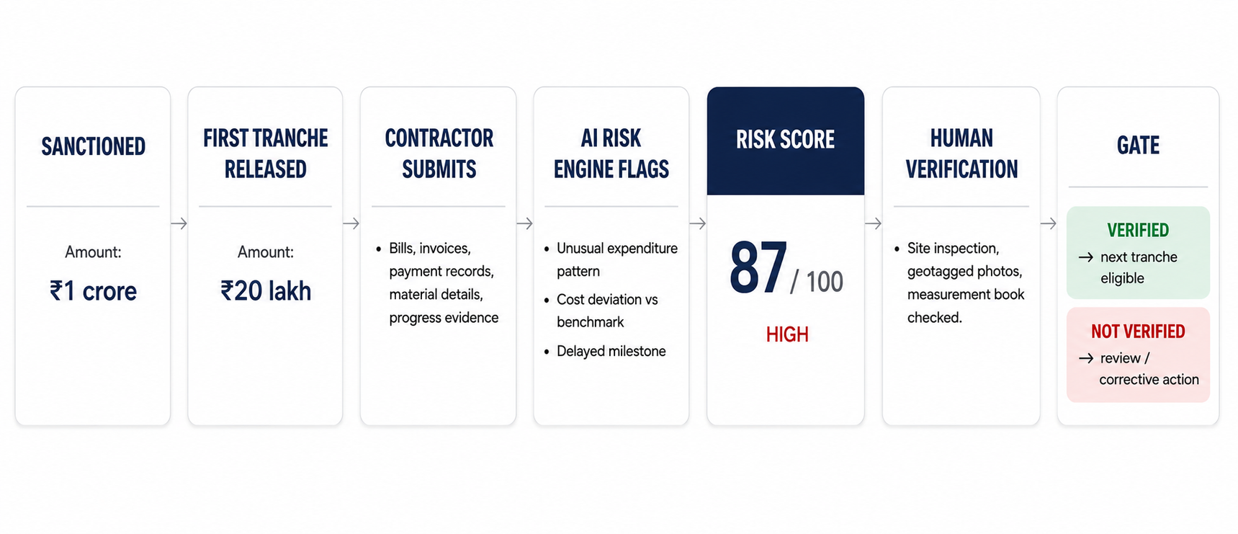
DietCode
One verified system — better decisions for every stakeholder.
Implementing Agency
District Authority
State / Ministry
Member of Parliament
Citizen
Clear milestone evidence means fewer disputed claims.
Risk-ranked projects focus attention where it matters most.
Verified utilisation data across districts.
Confidence that approved works are actually delivered.
Sees project status, progress and evidence locally.
ILLUSTRATIVE EXAMPLE — ROAD PROJECT
DETECTS RISK → VERIFIES WORK → RELEASES THE NEXT PAYMENT
MPLADS ArthSetu · SIH 26102 · Idea Submission
05
ArthSetu · SIH 26102 · Idea Submission
05

Slide 6
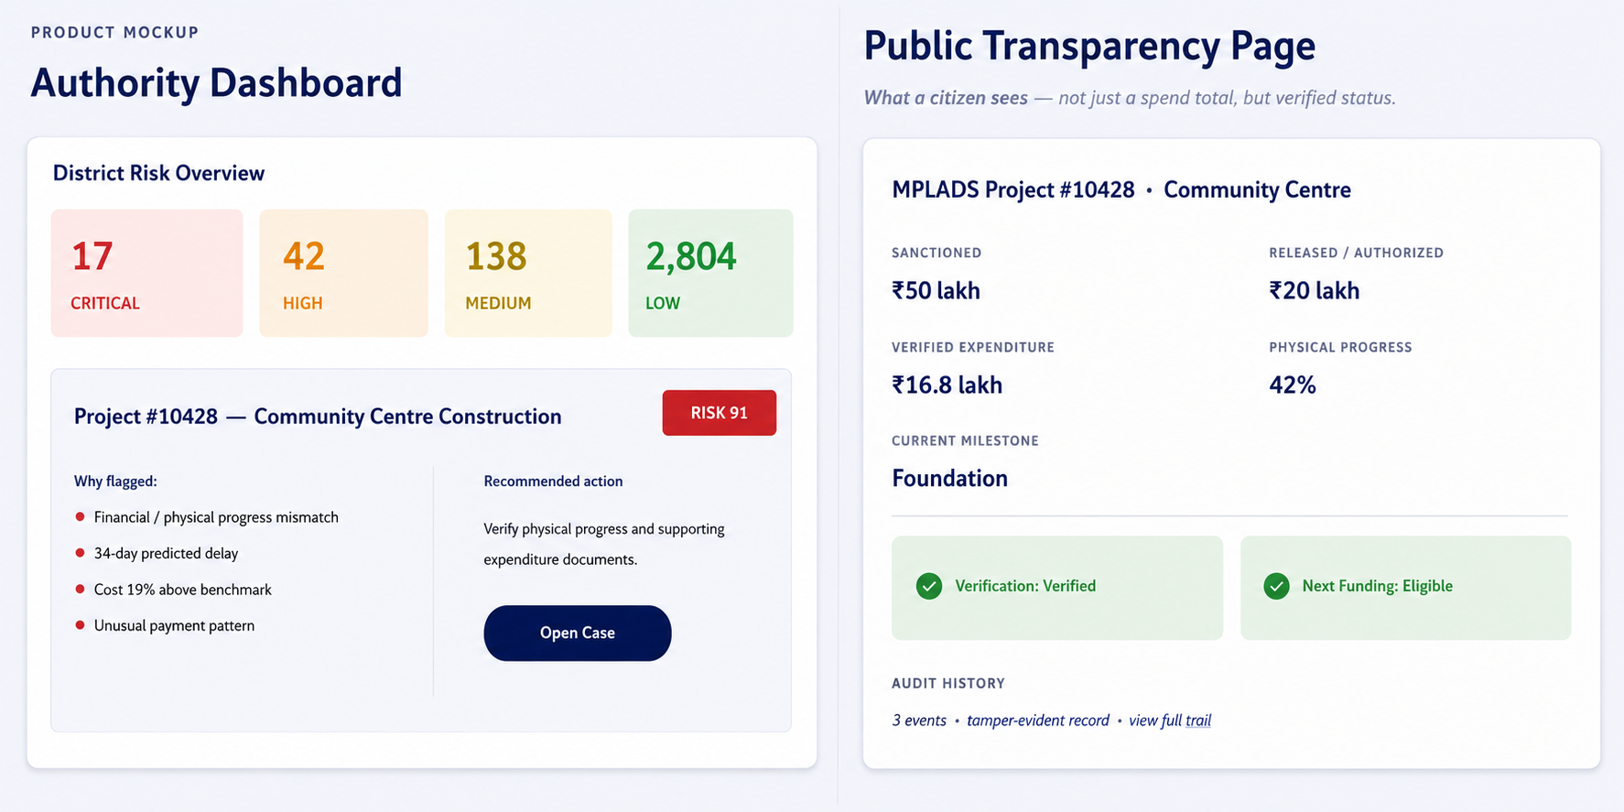

DietCode
TWO VIEWS, ONE TRANSPARENT SYSTEM
Clear milestone evidence means fewer disputed claims.Risk-ranked projects focus attention where it matters most.
Sees project status, progress and evidence locally.
06
MPLADS ArthSetu · SIH 26102 · Idea Submission
06
ArthSetu · SIH 26102 · Idea Submission

Slide 7

DietCode
ArthSetu is a modular, secure platform connecting data, AI, verification, and decision-makers
end-to-end.
TECHNICAL INFRASTRUCTURE
Data Ingestion Layer
Central Database
Rule Engine
TECH STACK
(Prototype)
• API Integration
• CSV / Excel Upload
• Secure File Upload
• PostgreSQL + PostGIS
• Compliance Checks
• Business Rules
• Threshold Monitoring
Frontend
React / Next.js
Document Processing & OCR
AI / ML Engine
Backend
Python / FastAPI
• OCR Extraction
• Data Validation
• Document Linking
• Anomaly Detection
• Risk Scoring
• Predictive Analytics
Database
ARTHSETU
PostgreSQL / PostGIS
AI / ML
AI-powered fund monitoring
& accountability platform
scikit-learn / XGBoost
GIS & Mapping
Analytics & Dashboards
OCR
• Work Location
• Geo-tagging
• Interactive Maps
• Role-Based Dashboards
• KPIs & Trends
• Drill-Down Insights
Tesseract / PaddleOCR
Maps
Leaflet / Mapbox
User & Access Management
Storage
Audit & Logging
Alert & Notification Engine
AWS S3 / MinIO
• Role-Based Access
• MP / State / District / Ministry
• Secure Authentication
Hosting
• Tamper-Evident Logs
• Action Tracking
• Compliance Trail
• Risk-Based Alerts
• Email / In-App Alerts
• Workflow Updates
Docker / AWS / Azure
MPLADS ArthSetu · SIH 26102 · Idea Submission
07
ArthSetu · SIH 26102 · Idea Submission
08

Slide 8
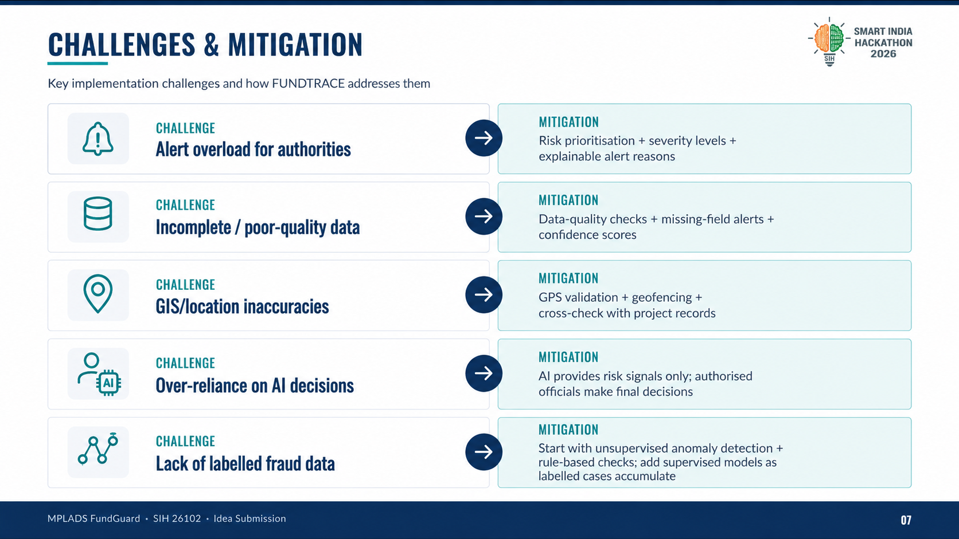

DietCode
Key implementation challenges and how ArthSetu addresses them
ArthSetu · SIH 26102 · Idea Submission
07
MPLADS ArthSetu · SIH 26102 · Idea Submission
08

Slide 9
DietCode
RESEARCH AND REFERENCES
1.
MPLADS Guidelines 2023 – Ministry of Statistics & Programme Implementation, Government of India, accessed August 26, 2026
https://www.mplads.gov.in/mplads/En/2034.aspx
2.
Members of Parliament Local Area Development Scheme (MPLADS) – Official MPLADS Portal, Government of India, accessed August 26, 2026
https://www.mplads.gov.in/
3.
Programme Implementation (MPLADS & IPMD) – Ministry of Statistics & Programme Implementation, accessed August 26, 2026
https://mospi.gov.in/programme-implementation-pi-wing
4.
Performance Audit of MPLADS – Comptroller and Auditor General of India (CAG), Report No. 31 of 2010-2011, accessed August 26, 2026
https://cag.gov.in/webroot/uploads/download_audit_report/2010/Union_Performance_Local_area_Development_Scheme_31_2010_chapter_8.pdf
5.
Compliance Audit – Fraudulent and Irregular Payment under Member of Parliament Local Area Development Scheme, CAG, accessed August 26, 2026
https://www.cag.gov.in/uploads/download_audit_report/2018/Chapter_3_Compliance_Audit_of_Report_No_4_of_2018_-_General_and_Social_Sector_Government_of_Gujarat.pdf
6.
MPLADS Portal – Work Register, Recommended Works, Completed Works and Status of Works, accessed August 26, 2026
https://www.mplads.gov.in/
7.
MPLADS Portal – Fund Release Statements, Expenditure Reports and Utilisation Certificate Formats, accessed August 26, 2026
https://www.mplads.gov.in/
8.
Digital India – Geospatial and GIS Data for Monitoring Infrastructure Projects, accessed August 26, 2026
https://bhuvan.nrsc.gov.in/
9.
Ministry of Electronics & IT – e-Office and Digital Governance Initiatives, Government of India, accessed August 26, 2026
https://www.meity.gov.in/
10.
NITI Aayog – Data-driven Governance and AI for Public Services, accessed August 26, 2026
https://www.niti.gov.in/
11.
PM GatiShakti – National Master Plan for Integrated Infrastructure Monitoring, accessed August 26, 2026
https://pmgatishakti.gov.in/
12.
Government of India – Public Financial Management and Transparency Initiatives, accessed August 26, 2026
https://www.pfm.gov.in/
ArthSetu · SIH 26102 · Idea Submission
MPLADS ArthSetu · SIH 26102 · Idea Submission
09
09

